Slide 1
Artificial Neural Networks
Key Concepts

Slide 2
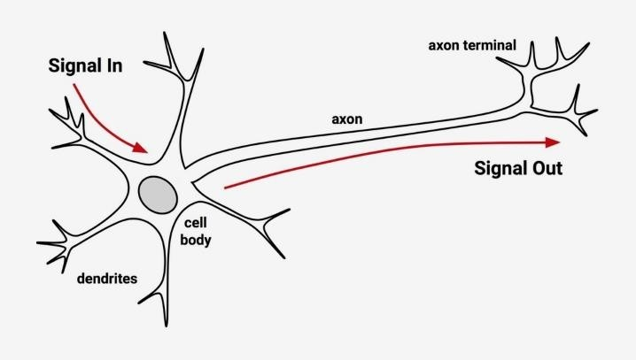
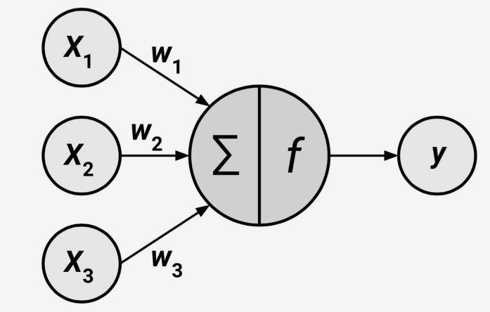
Neural Network

Slide 3
Key Concepts
Layers
Weights
Activation Functions / Transfer Functions
Loss Function
Back Propagation
Gradient Descent / Learning Rate
Other terms

Slide 4
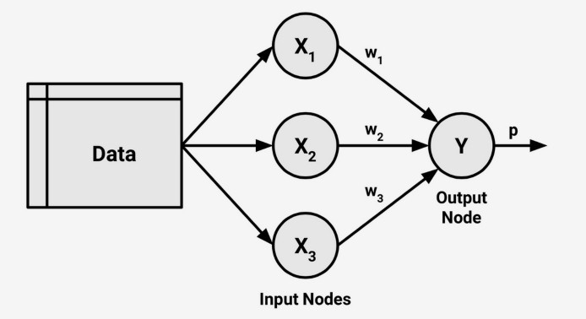
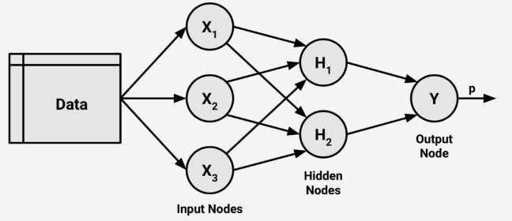
ANN - Architecture
Single Layer Network
Layers
Input Layer
Hidden Layer
Output Layer
Multi Layered Network

Slide 5
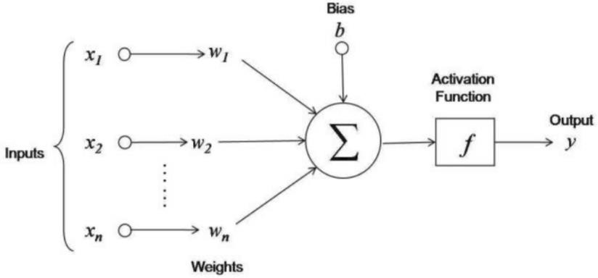
What happens inside each Neuron?
Output which is the input for the neurons of the next level hidden layer

Slide 6
Activation Function
Types of Activation Functions
Mechanism by which the neuron processes incoming information and passes it through the network
Unit Step Activation Function
Sigmoid Function
Hyperbolic ( Tanh)
ReLU (Rectified Linear Unit)

Slide 7
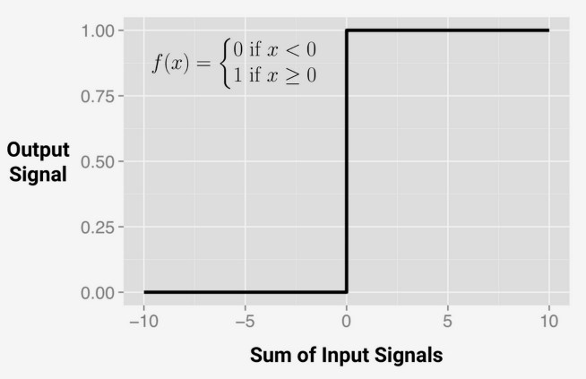
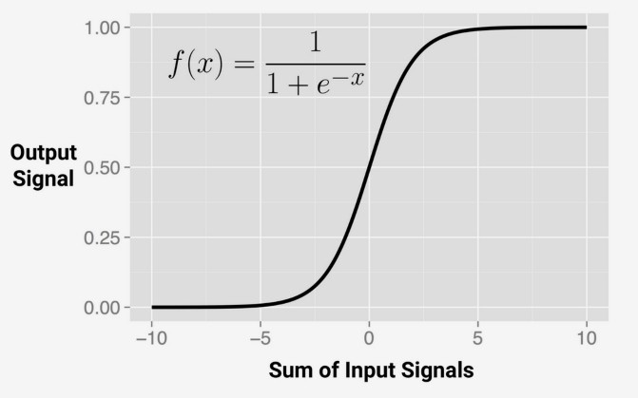
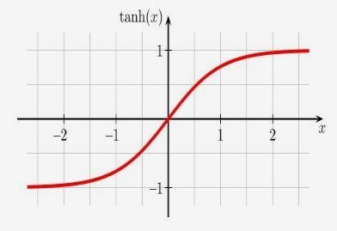
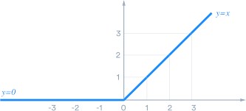
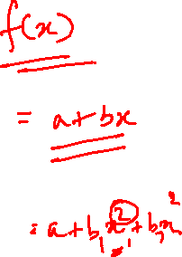
Activation Functions
Unit Step
Sigmoid
TanH
ReLU

Slide 8
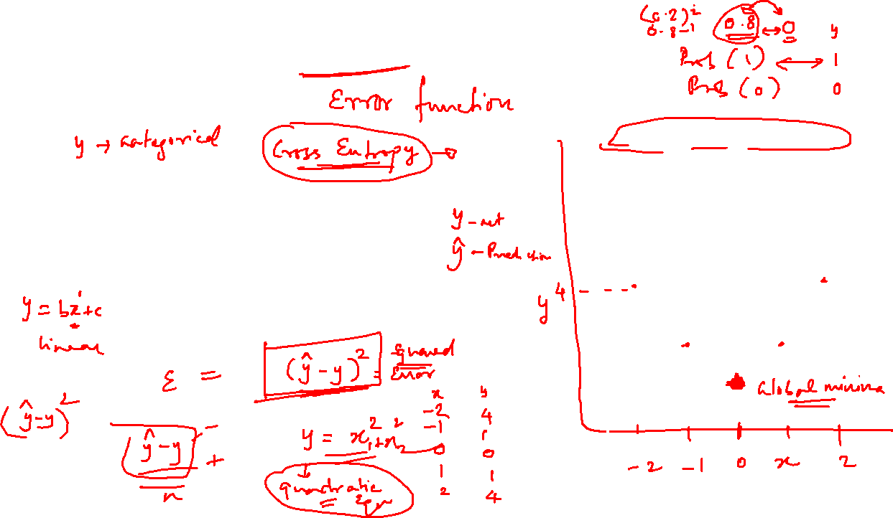

Loss Function / Cost Function

Slide 9
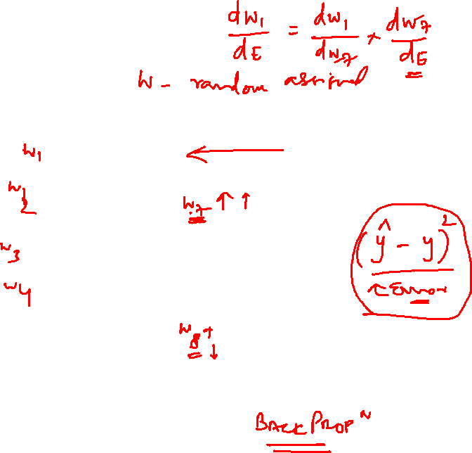
Back Propagation

Slide 11
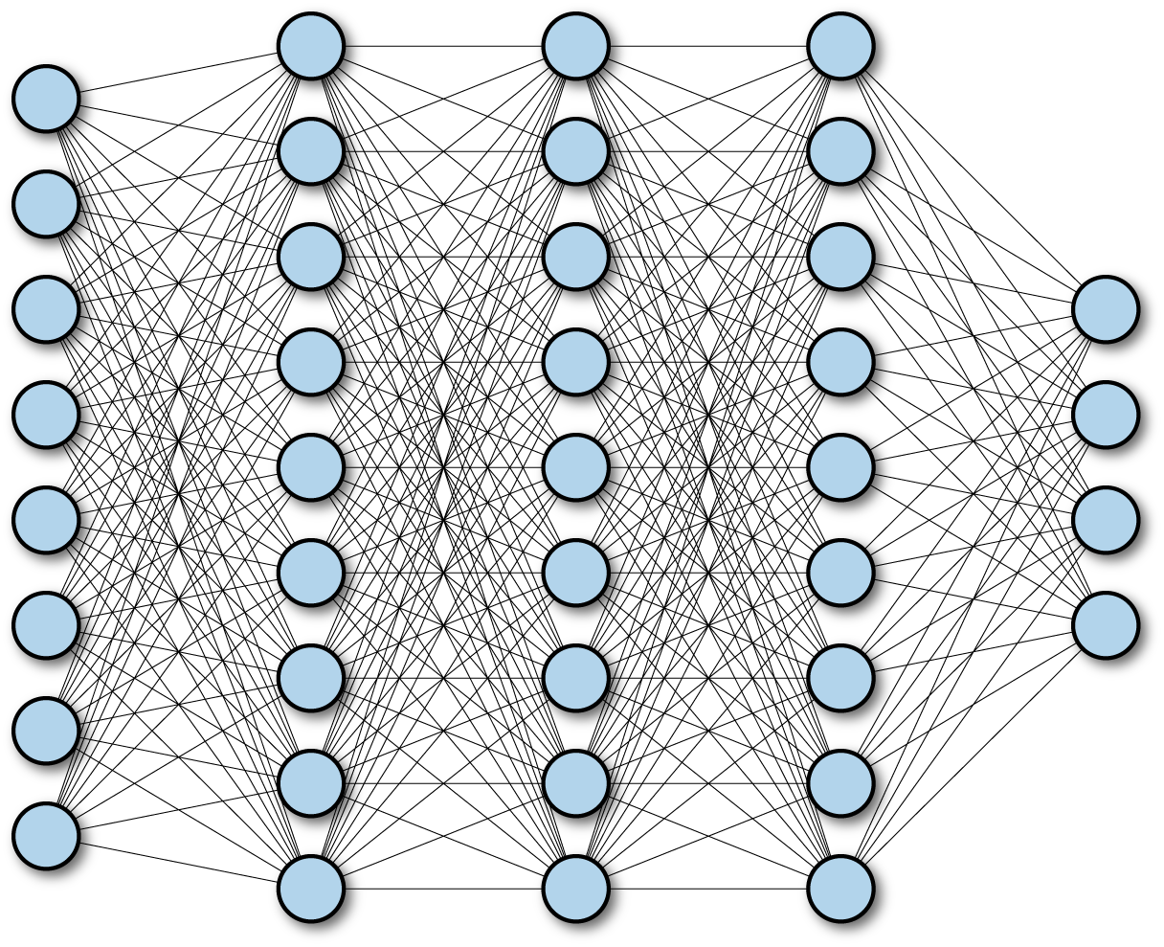
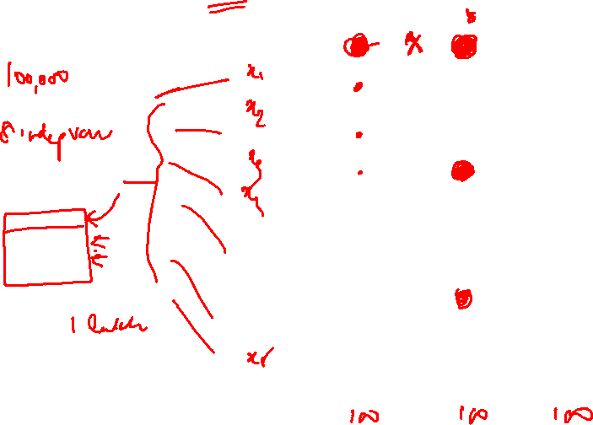
Fully Connected Neural Network
Image Source: TensorFlow for Deep Learning: From Linear Regression to Reinforcement Learning – B.Ramsundar & Bosagh Zadeh – O’Reilly

Slide 12

Gradient Descent & Learning Rate

Slide 13
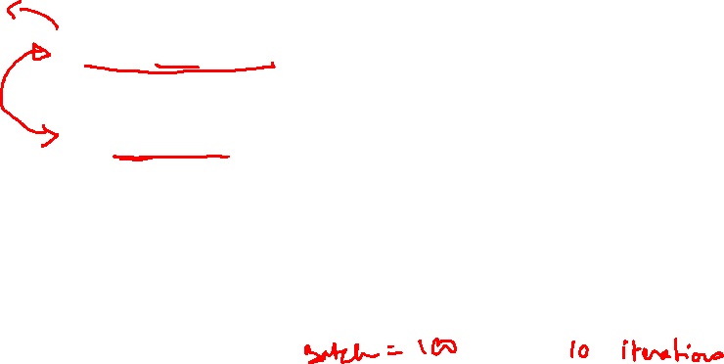
Other Important Terms
Epoch : one forward pass and one backward pass of all the training data rows
Batch Size: the number of training data rows in one forward/backward pass
Iterations: number of passes (One forward + One Backward = 1 pass)
e.g. If there are 1000 observations in training data and batch size = 500, then it will take 2 iterations to complete 1 Epoch.

